Slide 1
Ethics, Law, and E-commerce

Slide 2
Understanding Ethical, Social, and Political Issues in E-commerce
Internet, like other technologies, can:
Enable new crimes
Affect environment
Threaten social values
Costs and benefits must be carefully considered, especially when there are no clear-cut legal or cultural guidelines

Slide 3
A Model for Organizing the Issues
Issues raised by Internet and e-commerce can be viewed at individual, social, and political levels
Four major categories of issues:
Information rights
Property rights
Governance
Public safety and welfare

Slide 4
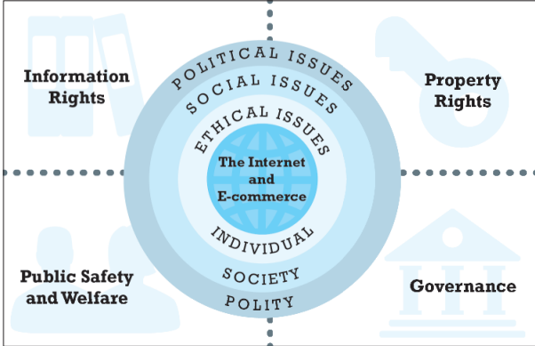
The Moral Dimensions of an Internet Society

Slide 5
Basic Ethical Concepts
Ethics
Responsibility
Accountability
Liability
Due process

Slide 6
Analyzing Ethical Dilemmas
Process for analyzing ethical dilemmas:
Identify and clearly describe the facts
Define the conflict or dilemma and identify the higher-order values involved
Identify the stakeholders
Identify the options that you can reasonably take
Identify the potential consequences of your options

Slide 7
Candidate Ethical Principles
Golden Rule
Universalism
Slippery Slope
Collective Utilitarian Principle
Risk Aversion
No Free Lunch
The New York Times Test
The Social Contract Rule

Slide 8
Privacy and Information Rights
Privacy
Moral right of individuals to be left alone, free from surveillance, or interference from other individuals or organizations
Information privacy
The “right to be forgotten”
Claims:
Certain information should not be collected at all
Individuals should control the use of whatever information is collected about them
Behavioral tracking on the Internet, social sites, and mobile devices

Slide 9
Privacy and Information Rights (cont.)
Threats to privacy
Personal information collected by commercial Web sites
Personal information collected by government authorities
Impact of mobile devices
Tracking people's locations and movements
Tracking personal behavior

Slide 10
Information Collected at E-commerce Sites
Data collected includes
Personally identifiable information (PII)
Anonymous information
Types of data collected
Name, address, phone, e-mail, social security
Bank and credit accounts, gender, age, occupation, education
Preference data, transaction data, clickstream data, browser type

Slide 11
Social Networks and Privacy
Social networks
Encourage sharing personal details
Pose unique challenge to maintaining privacy
Facebook's facial recognition technology and tagging
Personal control over personal information vs. organization's desire to monetize social network

Slide 12
Mobile and Location-Based Privacy Issues
Smartphone apps
Funnel personal information to mobile advertisers for targeting ads
Track and store user locations
Track users’ use of other apps
U.S. Supreme Court rules that police need warrant prior to searching a cell phone for information

Slide 13
Profiling and Behavioral Targeting
Profiling
Creation of digital images that characterize online individual and group behavior
Anonymous profiles
Personal profiles
Advertising networks
Track consumer and browsing behavior on Web
Dynamically adjust what user sees on screen
Build and refresh profiles of consumers
Google's AdWords program

Slide 14
Profiling and Behavioral Targeting (cont.)
Deep packet inspection
Business perspective:
Increases effectiveness of advertising, subsidizing free content
Enables sensing of demand for new products and services
Critics' perspective:
Undermines expectation of anonymity and privacy

Slide 15
The Internet and Government Invasions of Privacy
Government agencies are largest users of private sector commercial data brokers
Various laws strengthen ability of law enforcement agencies to monitor Internet users without knowledge, sometimes without judicial oversight
Encryption features implemented by Apple, Google for mobile phones

Slide 16
Legal Protections
In Ethiopia, privacy rights explicitly granted or derived from:
Constitution
freedom of speech and association
unreasonable search and seizure
due process
Specific statutes and regulations (federal and state)
Codes

Slide 17
Informed Consent and Notice
U.S. firms can gather and redistribute transaction information without individual's informed consent
Illegal in Europe
Informed consent:
Opt-in
Opt-out
Many U.S. e-commerce firms merely publish information practices as part of privacy policy or use opt-in as default

Slide 18
Technological Solutions
Spyware blockers
Pop-up blockers
Secure e-mail
Anonymous remailers
Anonymous surfing
Cookie managers
Disk/file erasing programs
Policy generators
Public key encryption

Slide 19
Intellectual Property Rights
Intellectual property:
All tangible and intangible products of human mind
Major ethical issue:
How should we treat property that belongs to others?
Major social issue:
Is there continued value in protecting intellectual property in the Internet age?
Major political issue:
How can Internet and e-commerce be regulated or governed to protect intellectual property?

Slide 20
Intellectual Property Protection
Three main types of protection:
Copyright
Patent
Trademark law
Goal of intellectual property law:
Balance two competing interests—public and private
Maintaining this balance of interests is always challenged by the invention of new technologies

Slide 21
Copyright
Protects original forms of expression (but not ideas) from being copied by others for a period of time
“Look and feel” copyright infringement lawsuits
Fair use doctrine
The Copyright and Neighbouring Rights Protection Proclamation no. 410/2004 (amended by 872/2014) and Regulation no. 305/2014
Ethiopia has not signed a number of major IPR treaties

Slide 22
Patents
Grant owner 20-year monopoly on ideas behind an invention
Machines
Man-made products
Compositions of matter
Processing methods
Invention must be new, non-obvious, novel
Encourages inventors
Promotes dissemination of new techniques through licensing
Stifles competition by raising barriers to entry
Inventions, Minor Inventions and Industrial Designs Proclamation no. 123/95 and Regulation no. 12/97

Slide 23
Trademarks
Identify, distinguish goods, and indicate their source
Purpose
Ensure consumer gets what is paid for/expected to receive
Protect owner against piracy and misappropriation
Infringement
Market confusion
Bad faith
Dilution
Behavior that weakens connection between trademark and product
Trademark Registration and Protection Proclamation No. 501/2006 and Regulation no. 273/2012

Slide 24
Trademarks and the Internet
Cybersquatting and brand-jacking
Cyberpiracy
Typosquatting
Metatagging
Keywording
Linking and deep linking
Framing

Slide 25
Who Governs the Internet and E-commerce?
Mixed mode environment
Self-regulation, through variety of Internet policy and technical bodies, co-exists with limited government regulation
ICANN : Domain Name System
Internet can be easily controlled, monitored, and regulated from a central location

Slide 26
Taxation
Non-local nature of Internet commerce complicates governance and jurisdiction issues

Slide 27
Net Neutrality
Net neutrality (Open Internet)
All Internet activities charged the same rate, regardless of bandwidth used
Differentiated pricing strategies
Cap pricing (tiered plans)
Speed tiers
Usage metering
Congestion pricing
Highway (“toll”) pricing
Comcast slows users for certain traffic
FCC's 2010 Open Internet Order
Netflix-Comcast agreement

Slide 28
Public Safety and Welfare
Protection of children and strong sentiments against pornography
Passing legislation that will survive court challenges has proved difficult
Efforts to control gambling and restrict sales of drugs and cigarettes
Currently, mostly regulated by state law
Unlawful Internet Gambling Enforcement Act

